Slide 1
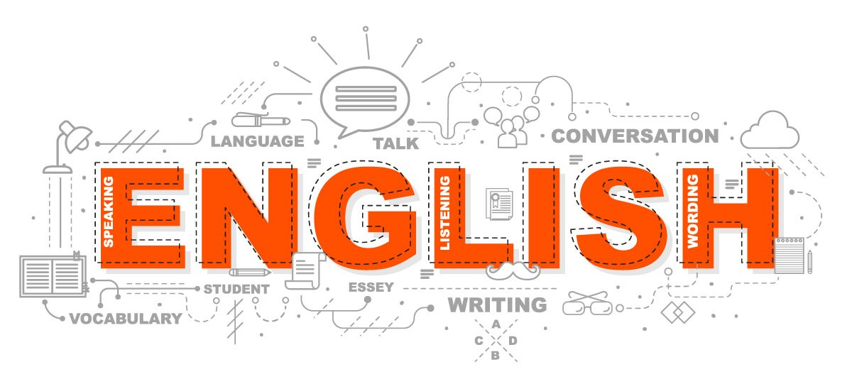
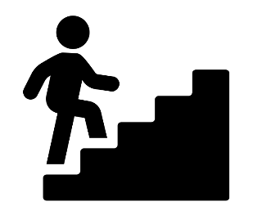
Everything you have learned across five years, brought together and applied under exam conditions.
Power and Conflict Poetry Students study the AQA anthology cluster poem by poem, building the skills to write comparatively across unseen and seen texts. The themes of conflict, power and human cost connect directly to the literature and contextual knowledge developed across KS3 and Year 10.
Macbeth: Students tackle Shakespeare's most psychologically complex tragedy, demanding high-level AO2 analysis of compressed, imagistic language. The Jacobean context deepens AO3 responses through power, manipulation and the tragic hero.
GCSE Literature and Language revision
We revisit all aspects of both GCSEs and ensure students are confident as they progress towards the summer exams
Mock Examinations Students sit full practice papers under timed conditions, applying everything developed across the course to Literature and Language questions. Mocks are used diagnostically — identifying gaps in knowledge, timing and exam technique that then drive the focus of revision in the final weeks.
FINAL
GCSE
EXAM
Mock Exams
Power & Conflict Poetry
YEAR
EXAM REVISION
Mastery
11
Students apply close analysis to Priestley's structurally precise drama, developing AO2 and AO3 skills through the play's rich social context — class, gender and capitalism. The moral arguments give students strong material for extended AO1 response.
Language Paper 2
Having developed their analytical skills in the autumn term, students will apply their skills to Paper 2 non-fiction, exploring the modes of letters, articles, speeches etc. across a range of topics.
Students encounter 19th-century prose as a full GCSE text. Dickens' use of symbolism and social critique develops AO2 and AO3 simultaneously, while the novella's accessibility makes it a vehicle for embedding extended essay writing before students face more demanding language later in the course.
Language Paper 1
Students develop the creative writing skills needed for Language Paper 1, exploring how published writers use structure, voice and sensory detail to create effect. Writing from stimuli, students practise crafting pieces that show rather than tell
Our GCSE texts teach us about moral responsibility, social pressure and the cost of our choices.
An Inspector Calls
Transactional writing
Conscience
A Christmas Carol
Creative Writing
Macbeth
What Will I Learn: Full novel study; independent analytical essay writing using P.E.T.A.L. Concepts: ethical philosophy, mortality and what makes life meaningful, power without accountability
Concepts: dystopia, allegory, totalitarianism, propaganda, what history tells us about how power corrupts
What will I learn:
Shakespeare’s play Othello, character analysis, manipulation through language
Concepts: tragic hero, hamartia, rhetoric, racism in Jacobean England
Concepts: verisimilitude, non-fiction tension, the human survival instinct, what the body and mind can endure
What Will I Learn: Survival accounts as stimulus for creative writing; making fiction feel authentic
Concepts: pathetic fallacy, Gothic pastiche, atmosphere, slow tension, grief and trauma, Victorian attitudes to death, repression and its consequences
What Will I Learn: Reading The Woman in Black; analysing how Susan Hill builds slow-burn terror; writing Gothic descriptive pieces using pathetic fallacy
YEAR
What Will I Learn: Extracts from The Hunger Games, Fahrenheit 451 etc.;
writer's intent
10
Concepts: P.E.T.A.L., moral ambiguity, stagecraft, collective responsibility, mob mentality, the bystander effect, gang culture, collective guilt
Scythe
Dystopian Worlds
Othello
Touching the Void
Survival
The Woman in Black
What Will I Learn: Reading DNA as a play text; writing sustained P.E.T.A.L. paragraphs; exploring how drama creates moral tension
What Will I Learn: Reading Noughts and Crosses as a performance text; analysing stage directions; writing analytical paragraphs linking fiction to real-world injustice
Concepts: stage directions, dramatic intent, apartheid, segregation, structural racism
What Will I Learn: Reading culture poetry from diverse voices; writing comparatively; exploring how place and identity shape what and how poets write
Concepts: comparative writing, identity, structure, cultural context, postcolonialism, diaspora, what it means to belong somewhere
What Will I Learn: Reading speculative short stories; writing imaginative fiction that builds its own world rules; developing show don't tell
Concepts: world-building, show don't tell, narrative voice, climate anxiety, technological change, who gets to imagine the future
DNA
Students face texts where power corrupts, fear controls and nothing is guaranteed.
9
What Will I Learn: Reading Much Ado About Nothing; inferring meaning beneath witty dialogue; analysing how Shakespeare presents relationships
Noughts & Crosses
Voices of the World
Speculative Fiction
YEAR
Concepts
inference, wit, status, dramatic irony, gender and marriage in Elizabethan society, gender and power
What Will I Learn: Reading Gothic short stories; writing atmospheric and tense descriptive pieces; understanding how Victorian writers created fear
Concepts: Gothic, pathetic fallacy, atmosphere, tension, Victorian society and industrialisation, the psychology of fear,
What Will I Learn: Reading Chinese Cinderella; biographical and autobiographical texts; linking personal experience to historical events
Concepts
biography, autobiography, chronology, China and communism, gender roles across cultures, family structures and expectations
Much Ado About Nothing
Victorian Nightmares
Chinese Cinderella
Worlds
Students explore worlds beyond their own — historical, cultural, fictional and political.
What will I learn:
extracts from Julius Caesar and A Midsummer Night's Dream; decoding Shakespearean language; understanding two contrasting genres
What Will I Learn: Reading and writing non-fiction; debating and constructing arguments; developing oracy skills around AI and technology
Concepts
viewpoint, argument structure, topic sentence, ethics of AI, surveillance, being human in a digital age
What will I learn
Reading a full novel chosen by the class; tracking character development
Concepts
narrative arc, character development, active reading, how fiction reflects the society that produces it
Technology: Friend or Foe
The Contemporary Novel
YEAR
Concepts
rhetoric, comedy, tragedy, context, character motivation
Introduction to Shakespeare
8
AO1 – read, understand and respond to texts
AO2 – analyse the language, form and structure used by a writer to create meanings
AO3 – show understanding of the relationships between texts and the contexts in which they were written
AO4 – use a range of vocabulary and sentence structures for clarity, purpose and effect, with accurate spelling and punctuation
What will I learn
A selection of poems based around childhood and experiences
Childhood and School Poetry
Students are introduced to the history of the English Language and storytelling over time
Origins of Story: The Odyssey
Heroes and Villains
YEAR
Foundations
7
Concepts
imagery, voice, word class, noun, verb, technique
What will I learn
Performance through Simon Armitage’s dramatization of The Odyssey
Concepts
Oral tradition, Epic form/ hero/villain,
What will I learn?
Students will learn how to read about, analyse, then create and write their own archetype characters.
Concepts
Good Vs. Evil, Character Development
Foundations unites the schemes of learning for Year 7

