Slide 1
KS3

Slide 2






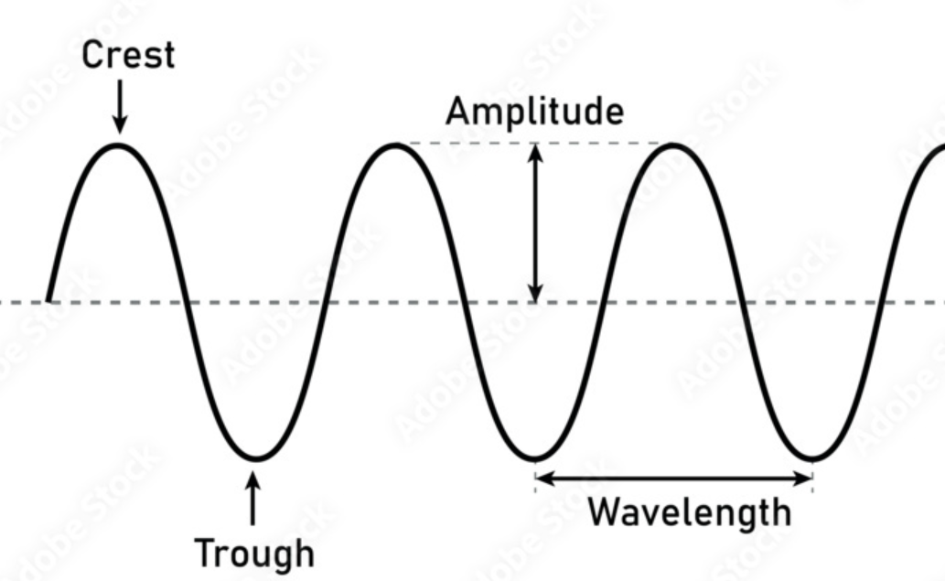




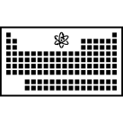









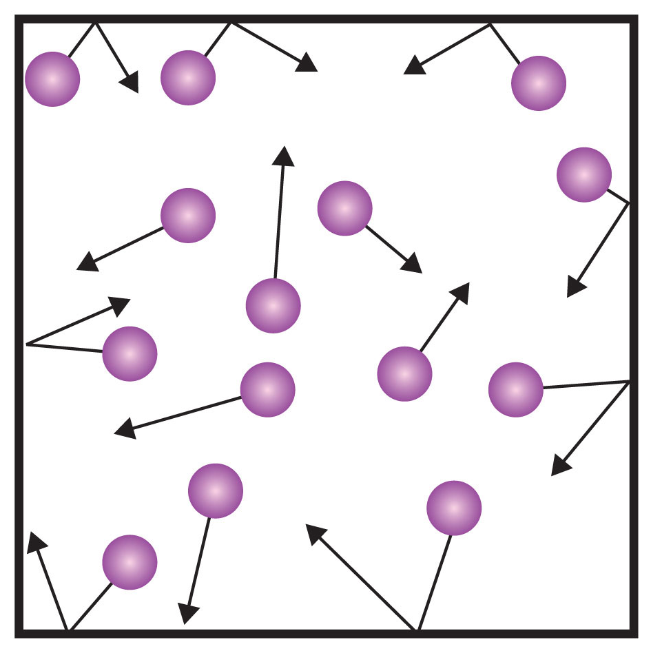

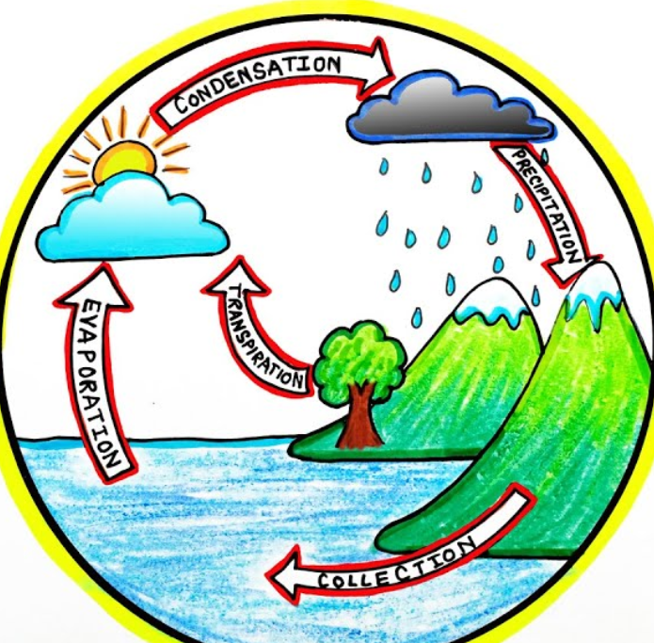
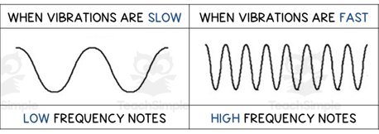
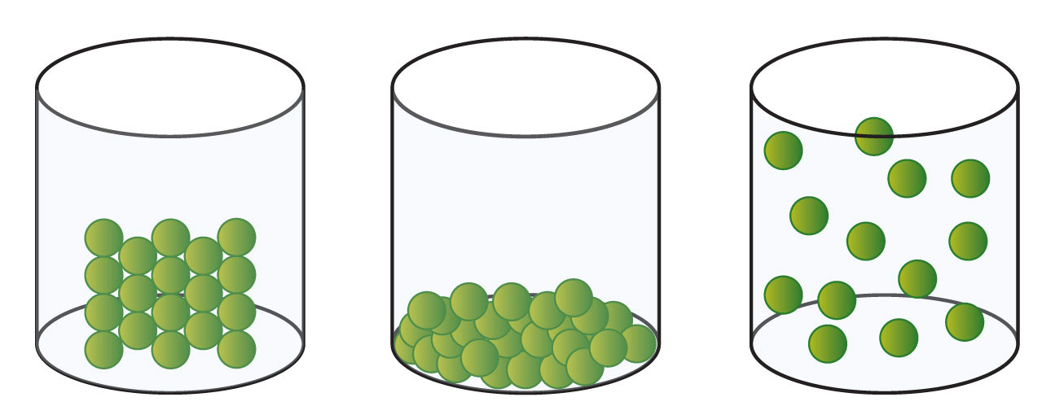

































Science KS2 –KS3
Move to year 9 pre GCSE
Organisms ( breathing & digestion)
Electromagnet( magnetism)
Waves ( effects & properties)
Energy 9 work, heating and cooling)
Ecosystem
( photosynthesis)
Matter (elements, periodic table)
Earth ( climate)
End of year test
Mid term assessments
Component 2 Practical exam
YEAR
YEAR
8
Reactions (types of reaction, chemical energy)
11
Organisms
( movement and cells)
Reaction ( Acids/alkalis, non metals & metals
Electromagnets (resistance & current
‘
Forces ( contact forces, pressure)
Forces
Earths structure
Mid term assessments
Energy & waves
Intro to science
Matter
Ecosystems
Genes ( human reproduction)
Evolution & inheritance
Light
Water transport
‘Animals including humans part 2
7
Assessment 3
Assessment 2
Animals including humans part 2
Living things & their habitats
Electricity and sound
Assessment 1
Animals including humans
YEAR
Electricity
6
Assessment 3
Animals including humans
States of matter
Assessment 2
Assessment 1
Living things & their habitats
Animals including humans part 2
Electricity and sound
Assessment 3
YEAR
5
Assessment 2
States of matter
Assessment 1
YEAR
4
Animals including humans
Living things & their habitats

Slide 3
KS4

Slide 4


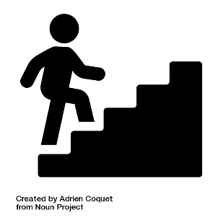
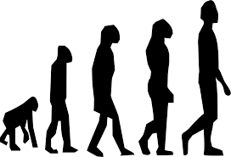
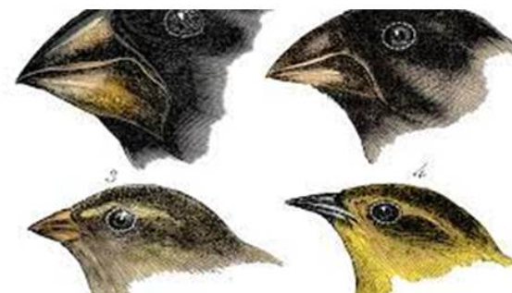

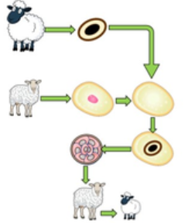
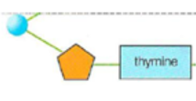




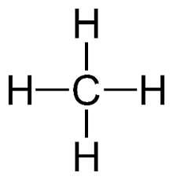
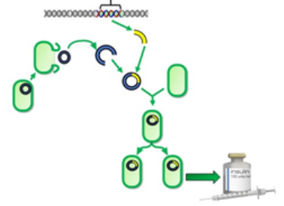

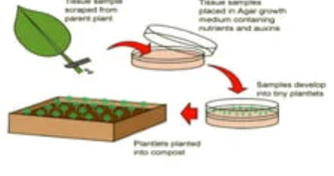


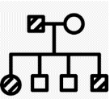









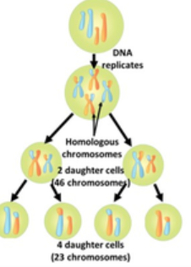



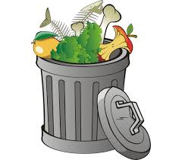






















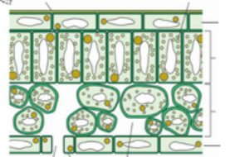


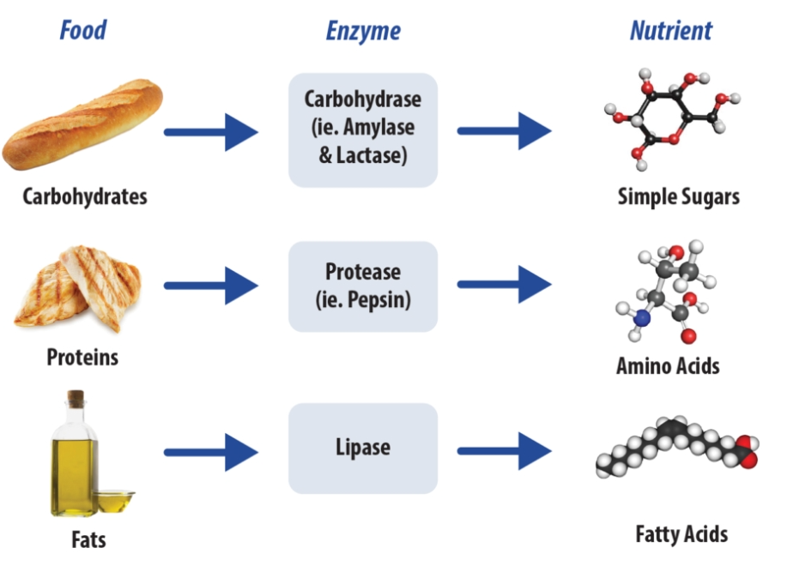

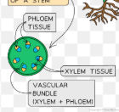








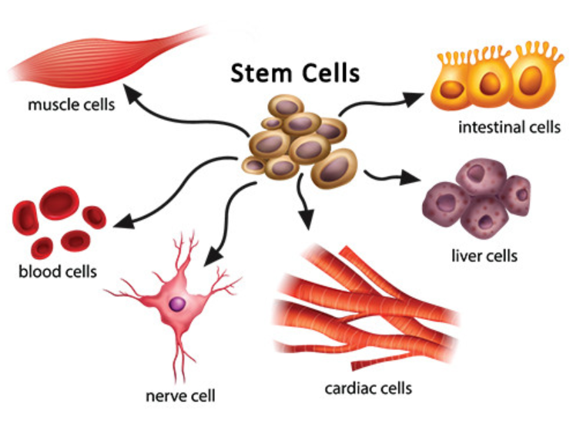








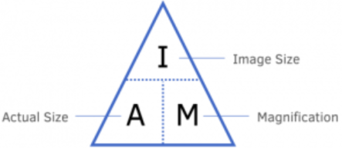





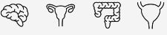

The Compass school KS4 Biology
Currently year 9 ,10 and 11 doing GCSE Biology
Separate science
Exam preparation
End of year exams!!
Other post 16 options – Apprenticeships, other A level subjects, other BTEC subjects, other training, College?
A level Sciences – Biology, Chemistry and Physics
(Need grade 6 and above and grade 6 in Maths)
Evolution:Charles darwin
DNA structure: nucleotide base pairs
Genetic engineering
x
Fusion cell cloning
Greenhouse gases
Understanding genetics and evolution
x
DNA structure: base pairs , Nucleotide
Tissue culture
x
x
Protein synthesis: Transcription and translation
Punnett squares
B6 Inheritance, variation and evolution
Reproduction
IVF
Genetic crossing/family pedigree
Contraception
The menstrual cycle
Hormonal control in humans
Mitosis –cell division
Sexual asexual reproduction
B5 Homeostasis and response- part 2
Variation and evolution
Homeostasis
Recycling and conservation
B5 Homeostasis and response
Mieosis –cell division
Food security
x
The nervous system
YEAR
11
Classification
Diabetes
Decomposers and decay
Thermoregulation
Organization of an ecosystem
Biodiversity and human interaction
aerobic respiration
Photosynthesis reaction/limiting factors
Use of glucose
Photosynthesis
x
10
Human defense systems and vaccination
Adaptations
Food chains, webs and pyramid of biomass
B7 Ecology
B4 Bioenergetics
Discovery and development of drugs
Biotic & abiotic factors
Quadrats transects: Sampling techniques
Plant organ systems
Health and disease
Discovery and development of drugs
Enzymes and digestion
x
Painkiller vs antibiotics
Communicable diseases
Cells , tissues
The circulatory system
B3 Infection and response
Human defense systems
B2 Organization
Digestive system, enzymes and food tests
Mitosis , binary fission
Exchange surfaces and SA:V
Immune system: phagocytes, Lymphocytes
Pathogens: bacteria, virus, fungi, protists
Arteries, veins capillaries
Cell division and stem cells
B1 Cell biology
YEAR
9
Sterile technique
Cell structure, specialization and microscopy
X
Stem cells
Principles of organization
Transport in cells
Diffusion, osmosis and active transport

