Slide 1
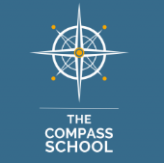
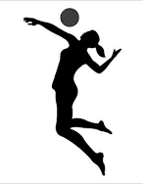


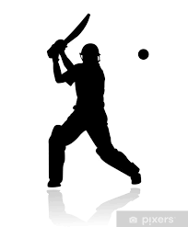
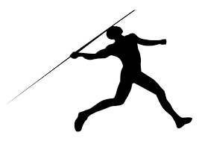
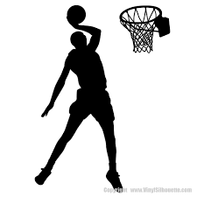
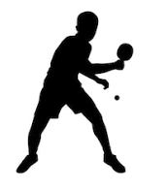

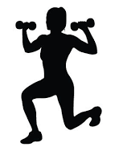



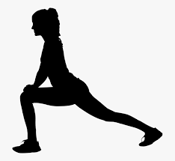


Physical Education Learning Journey
The Compass School Years 4-9 - Key Stage 2 & 3
Athletics
Net and Wall Games
Level 1 Certificate in Sport
Striking and fielding
E
XE
CUTE
Striking and fielding
Athletics
Invasion Games
Invasion Games
Year
9
Fitness
Net and Wall Games
Fitness
Striking and fielding
Year
8
Invasion Games
Invasion Games
Athletics
E
M
BED
Striking and fielding
Athletics
Invasion Games
Net and Wall Games
Year
7
Invasion Games
Net and Wall Games
Fitness
Invasion Games
Invasion Games
Athletics
Year
6
Invasion Games
Gymnastics
Striking and fielding
E
X
P
L
O
R
E
Invasion Games
Year
4/5
Gymnastics
Net and Wall Games

Slide 2













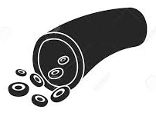

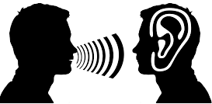

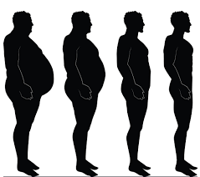




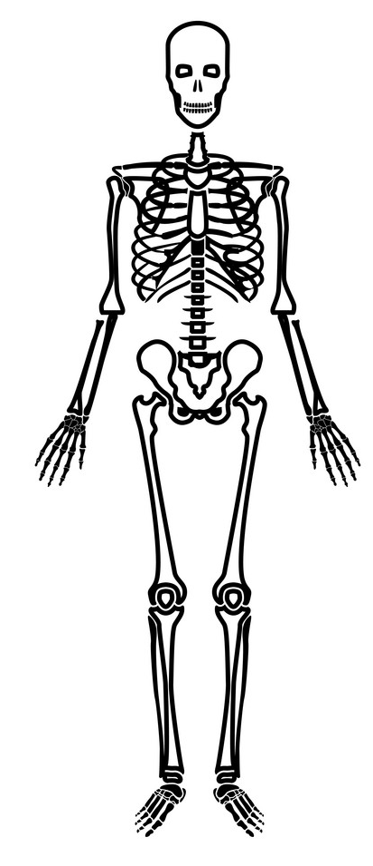
Physical Education Learning Journey
The Compass School Years 10-11 - Key Stage 4
Unit 3 Submission
Finalising Coursework Submission
Other post 16 options
BTEC Level 2/3 Diploma in Sport and Exercise science
Unit 4 Submission
Unit 5 Submission
Unit 2 Submission
End of Unit 5
3.4
Follow the Nutrition Plan
3.1- 3.2
Different Diet and there benefits
2.3
Importance of Hydration
2.1-2.2
Signs of Vitamins & Minerals Deficiency
Unit 1 Submission
1.5.
Food Sources of Vitamins & Minerals
3.5
Ways to Promote a healthy Diet
3.3
Create a Nutrition Plan
2.4
Reasons for a balanced Diet
5.6
Short and Long term effects of exercise on the heart
End of Unit 3
2.1
Assisting at an event
2.3 Goal Setting
End of Unit 4
1.2.
Function of food groups
1.4.
Vitamins & Minerals
5.1 – 5.4
Function and Location of Circulatory System
YEAR
11
1.3.
Food sources
4.5
Short and Long term effects of exercise on lungs
1.1.
The Leisure Industry
1.2
Different Sporting Event
2.2
Preparing for an Event
3.1
Assist in the Sports Event (Sports Day)
1.1.
Major Food groups
3.3
Types and functions of muscles
3.1
Characteristics of Muscles
2.5
Ligaments and Tendons
2.3
Types of Synovial Joint
2.2
Types of Bones
1.3.
Factors affecting physical Fitness
4.4
Gaseous Exchange
1.2.
Components of physical Fitness
4.1 – 4.3
Function and Location of Respiratory Organ
End of Unit 2
3.4
Short and Long term effects of exercise on muscles
3.2
Characteristics of Tendinous tissue
2.6
Short and Long term effects of exercise on skeleton
2.4
Structure of a Synovial Joint
2.3
Types of Joints
2.1 Function of the Skeleton
1.1.
Total Fitness
3.2 Review Areas of development in Sports
1.1. Reasons for participating in sport
1.3. Categories of Sport
2.1 Participate in Individual Sports
2.3 Skills and Techniques used in Sports
1.1.
Total Fitness
End of Unit 1
3.2 Review Strengths in Sports
3.3 Purpose of Warm Up/ Cool Down
3.3 Fitness Testing
1.2 Characteristics of Sport
3.1 Develop and Review participation in Individual and Team Sports over time
1.4 National, Regional and Local Venues
2.2 Participate in Team Sports
2.4 Equipment and resources used in Sports
3.3 Fitness Testing
2.3 Components of fitness
2.1 What is Health
1.1. Structure of Cardiovascular System
1.1 structure of the Respiratory
3.3 Fitness Testing
YEAR
10
3.3 Fitness Testing
3.2 Health and Safety
3.1 Benefits for participating
2.2 Principles of Training
1.2 Effects of exercise on body
1.1. Structure of the Muscular System
1.1. Structure of the Skeletal System

